Slide 1

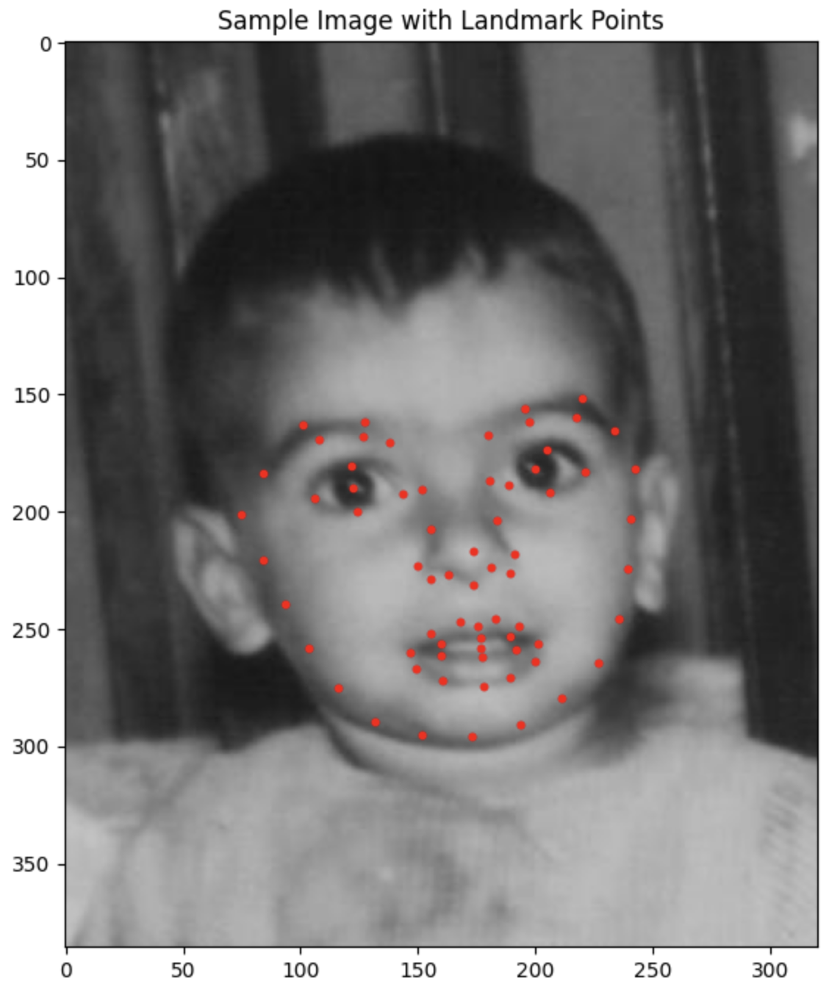
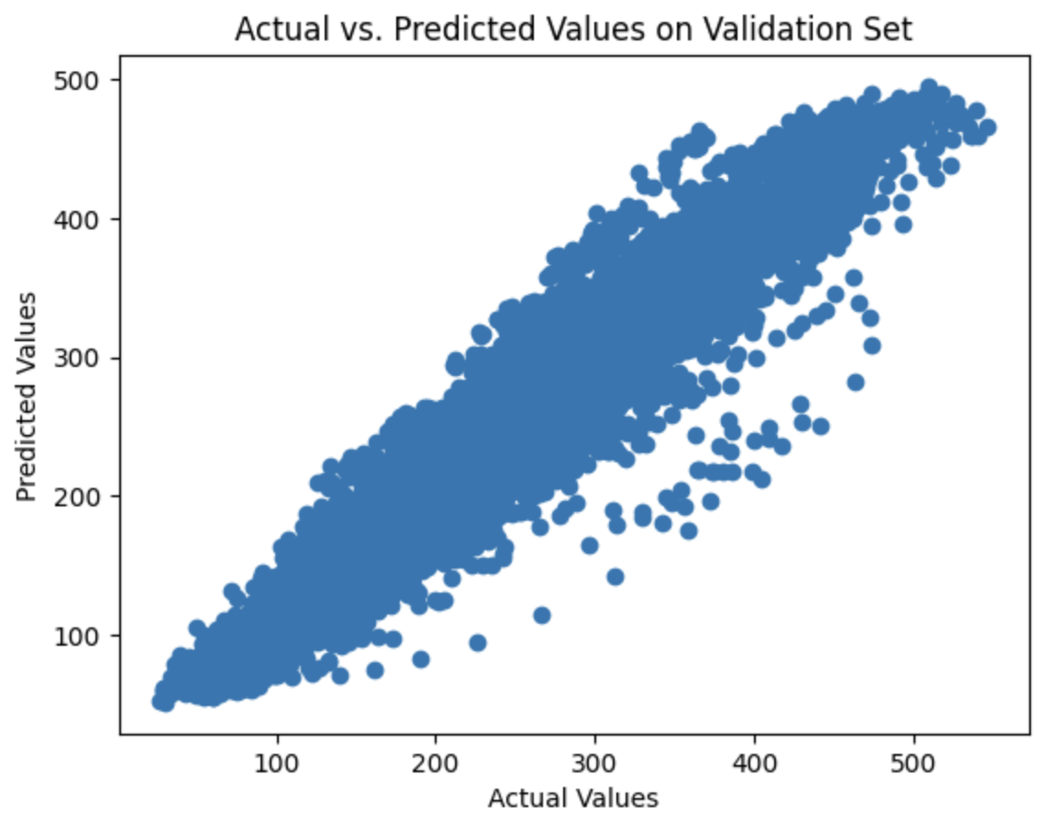
AI-Powered Image De-Aging: A Technical Exploration
AJAY KASU
Pace University, Seidenberg School of Computer Science and Information Systems | Advisor: Dr. Christelle Scharff
DATASET:
The FG-NET dataset is a publicly available dataset for age estimation and face recognition across ages. It consists of 1,002 images of 82 individuals with ages ranging from 0 to 69 years old.
An age gap of up to 45 years for some individuals. Facial landmark annotations for each image (68 points). It is often used for face verification across large age gaps. The dataset contains images ranging from child/young to adult/old.
METHODOLOGY:
Preprocessing: Crop and align facial images to ensure consistency in facial features. Annotate facial landmarks in the images to provide key points for feature extraction and CycleGAN training.
Feature Extraction using ResNet50: Utilize the ResNet50 architecture to extract high-level features from the facial images. Fine-tune the pre-trained ResNet50 model on the annotated dataset to enhance its ability to capture age-related features.
Age Range Categorization: Define age ranges to categorize individuals into "young" and "old" groups based on ground truth ages. Create labels for the age categories for supervised learning in the next steps.
Supervised Learning with Random Forest (RF): Train a Random Forest classifier using the extracted features as input and age categories as labels. Evaluate the RF model's performance on a separate validation set.
5. CycleGAN Training: Implement a CycleGAN architecture for image translation, focusing on de-aging. Prepare paired training data, consisting of original images and corresponding age-decreased versions. Train the CycleGAN model to learn the mapping between young and old faces bidirectionally.
6. Model Evaluation: Evaluate the de-aging performance of the CycleGAN model using a separate test set. Use qualitative measures, such as visual inspection, and quantitative measures, like Structural Similarity Index (SSI) and perceptual metrics.
EDA:
RESULTS:
CONCLUSION AND FUTURE WORK:
In my exploration of AI-powered image de-aging, I successfully harnessed ResNet50 for feature extraction and Random Forest for accurate age categorization. The integration of CycleGAN proved transformative, producing realistic de-aged images.
As I conclude this phase, the project signifies a promising start rather than an endpoint. Future work involves refining de-aging quality, venturing into video de-aging, and addressing ethical considerations. This exploration reflects a commitment to pushing AI boundaries, emphasizing both technical innovation and ethical responsibility.
REFERENCES:
Liu, S., Sun, Y., Zhu, D., Bao, R., Wang, W., Shu, X., Yan, S., & Yan, S. (Year). Face Aging with Contextual Generative Adversarial Nets.
High Resolution Face Age Editing Xu Yao, Gilles Puy, Alasdair Newson, Yann Gousseau, Pierre Hellier https://arxiv.org/abs/2005.04410v1
Zhu, J.-Y., Park, T., Isola, P., & Efros, A. A. (2017). Unpaired Image-to-Image Translation using Cycle-Consistent Adversarial Networks. In Computer Vision and Pattern Recognition (CVPR).
Suo, J., Zhu, S.-C., Shan, S., & Chen, X. (2009). A Compositional and Dynamic Model for Face Aging. Journal of LaTeX Class Files, Volume number(Issue number), Page range. DOI/Publisher.
ABSTRACT:
This technical exploration delves into the innovative realm of AI-powered image de-aging, leveraging advanced machine learning techniques to rejuvenate facial images. My primary goal is to create a robust and adaptable model that can realistically de-age facial features while preserving essential characteristics.
RESEARCH QUESTION:
How does the integration of facial landmarks enhance the precision of image de-aging?
How can AI-powered image de-aging be effectively applied in the entertainment industry, such as movies and TV shows?
In what ways can de-aging technology assist in forensic analysis, such as age progression analysis for missing persons?
Key Components:
CycleGAN Architecture:
Dual generators and discriminators for seamless bidirectional transformation.
Cycle consistency to ensure the preservation of facial features in both directions.
Facial Landmarks Integration:
Utilization of facial landmarks for precise alignment during the de-aging process.
Improved handling of individual facial expressions and distinctive features.

